Slide 1

FPGA-Based Pulsar Signal Decoder with Pulsar Database Matching
Author: Chirag V Rao
Context: Internship in MIT Manipal

Slide 2

Introduction & Motivation: The Hunt for Cosmic Clocks
The motivation for this project comes from the intriguing behavior of an astronomical entity called millisecond pulsars (MSPs), which are neutron stars spinning at incredibly high speeds — often hundreds of times per second. What makes MSPs so fascinating is their extreme rotational stability and the precision of the radio pulses they emit, making them some of the most accurate natural clocks in the universe. Unlike regular pulsars, MSPs have been "recycled" through interactions with a companion star, allowing them to spin faster and remain stable over long periods. This stability and periodicity make them ideal candidates for signal detection and timing experiments. The core idea of this project is to simulate the detection and identification of these cosmic lighthouses using hardware by accurately measuring their pulse periods — a task that highlights both the technical challenge and the scientific wonder of observing such precise astronomical phenomena.
This work provides practical exposure to digital system design, real-time embedded processing, and the integration of hardware with scientific data pipelines—skills highly relevant in astrophysics, VLSI, and space instrumentation research.

Slide 3
The Journey: From a Simple Idea to a Professional Algorithm
This project followed a path of discovery, starting with a simple concept and evolving to embrace a more robust, professional-grade algorithm.
The Initial Approach: A Simple Period Counter
1
2
Detect Rising Edges
Measure Clock Cycles
The system was designed to detect the rising edges of an incoming digital pulse signal.
It would measure the number of clock cycles between two consecutive rising edges using a high-frequency counter.
3
4
Convert to Usable Units
Encode & Transmit
This raw clock cycle count would then be converted into a usable unit like milliseconds.
Finally, this period would be encoded into a digital "beacon" frame for transmission.
This initial approach was simple to implement and worked perfectly for an ideal, clean signal.

Slide 4

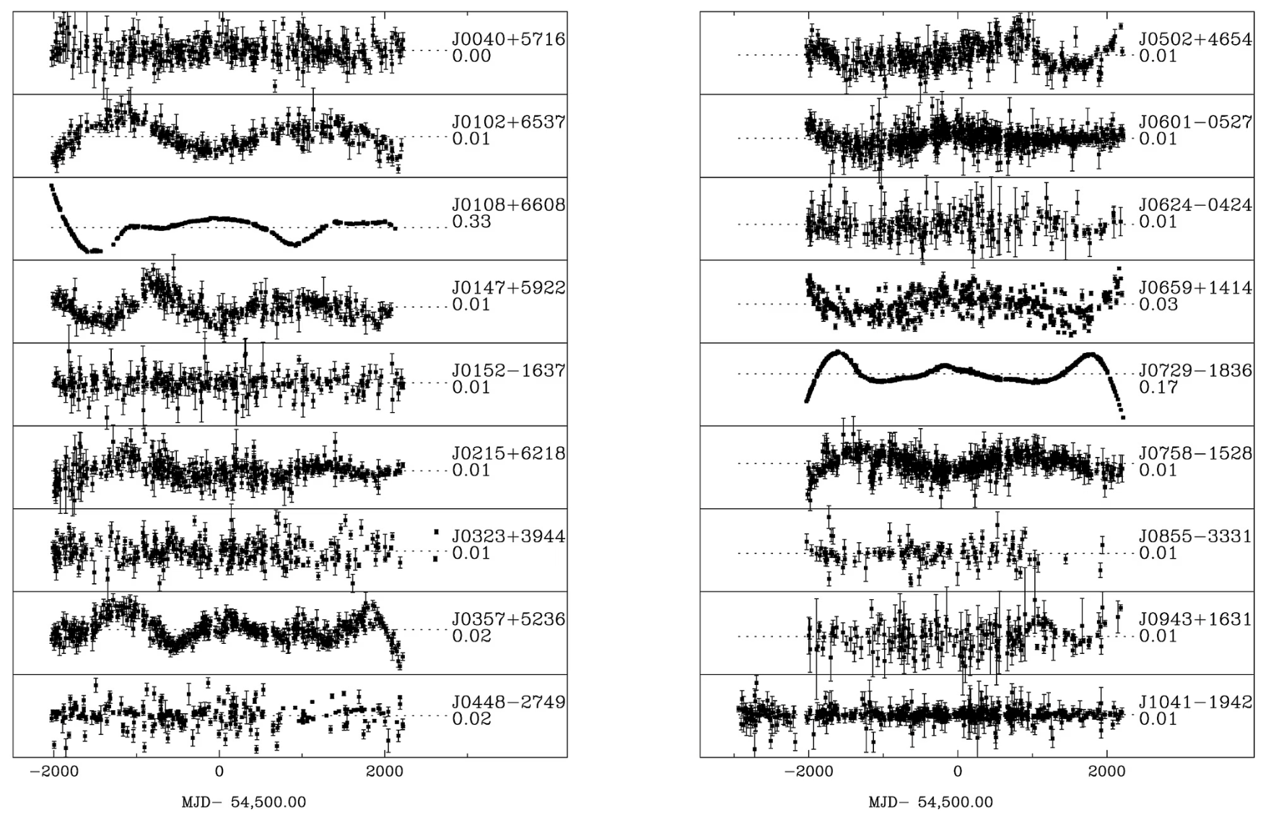
The Critical Flaw: The Reality of Astronomical Signals
Research into real pulsar data revealed a critical flaw in this simple approach. A real signal from a radio telescope is not a clean pulse train; it's often incredibly faint and buried in a tremendous amount of data and noise.
A simple edge detector fails because:
Low Signal-to-Noise Ratio (SNR): The actual pulse is often weaker than the background noise, leading to incorrect period measurements from random noise spikes.
No Definable "Edge": The signal is a slight statistical increase in power, not a sharp, clean rising edge.
Signal Contamination: Pulsar observations are often contaminated by "red noise," a type of low-frequency noise that can mimic periodic signals and create misleading patterns in the data, making real pulse detection even harder.
This led to the critical conclusion that one cannot reliably detect a pulsar by looking for individual pulses. The only viable method is to average thousands of pulses together to make the signal stand out from the noise.

Slide 5

The Pivot: Adopting the Fast Folding Algorithm (FFA)
This conclusion prompted a shift in methodology. Following the expert guidance of Dr. P. Sreekumar, a distinguished ISRO scientist renowned for his expertise in space instrumentation, the project pivoted to the Fast Folding Algorithm (FFA).
The FFA is a powerful and conventionally used time-domain technique in professional radio astronomy that is designed specifically for this challenge. It works by taking a long stream of data, cutting it into segments of a specific "trial period," and stacking them on top of each other. If the trial period is correct, the faint pulses in each segment align and add up, creating a strong, clear signal that rises above the noise.
This method is superior for two key reasons:
More Sensitive: The FFA is a phase-coherent algorithm, naturally capturing and combining power from all pulsar signal harmonics, crucial for sharp, narrow MSP pulses.
More Robust: It is naturally more resistant to "red noise," leading to fewer false detections.

Slide 6
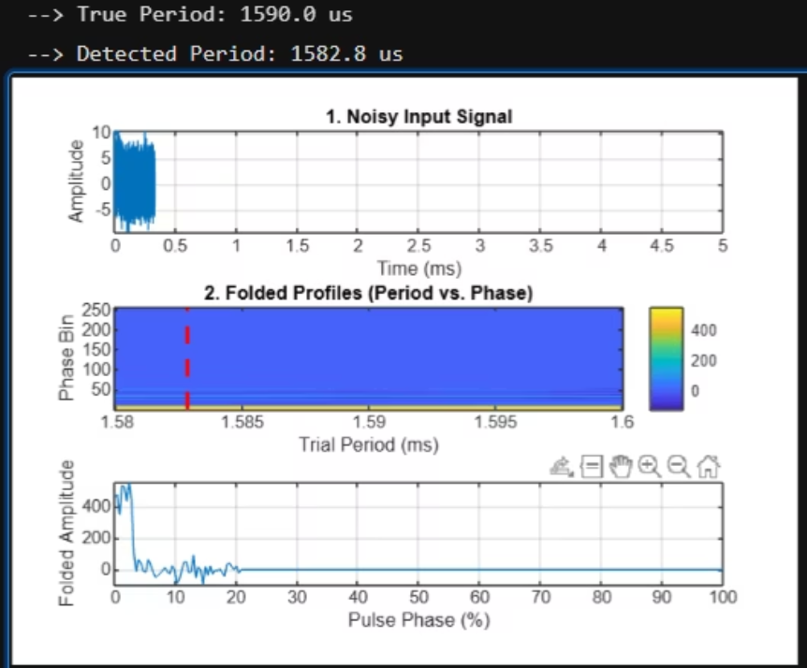
Matlab Representation:
% MATLAB script to demonstrate the Fast Folding Algorithm (FFA)% This models the logic inside your ffa_engine.v module.clear; clc; close all;%% 1. Setup and Parametersfprintf('Setting up simulation parameters...\n');fs = 50e6; % Clock frequency in Hz (50 MHz)dt = 1/fs; % Time step in seconds% Parameters matching your Verilog testbenchpulsar_period_s = 1.590e-3; % True period of the simulated pulsar (1590 us)pulse_width_s = 0.05e-3; % Width of the pulse (50 us)data_buffer_size = 16384; % Number of samples to processprofile_bins = 256; % Number of phase bins in the folded profile% Create a time vector for our data buffertime_vector = (0:data_buffer_size-1) * dt;%% 2. Generate a Realistic Noisy Signalfprintf('Generating a noisy pulsar signal...\n');noise_amplitude = 2.5;pulse_amplitude = 1.5;% Create a baseline of random noisenoise = noise_amplitude * randn(1, data_buffer_size);% Create a periodic pulse train using the modulo functionpulse_signal = (mod(time_vector, pulsar_period_s) < pulse_width_s) * pulse_amplitude;% Combine them to create the final signalinput_signal = noise + pulse_signal;%% 3. The Core FFA: Folding and Accumulationfprintf('Starting the Fast Folding Algorithm...\n');% Define the range of trial periods to search around the true periodtrial_periods_s = linspace(1.58e-3, 1.60e-3, 200); % Search 200 periodstrial_periods_samples = round(trial_periods_s / dt);% Initialize a matrix to store all the folded profilesfolded_profiles = zeros(length(trial_periods_samples), profile_bins);% Main FFA loopfor p_idx = 1:length(trial_periods_samples) current_trial_period = trial_periods_samples(p_idx); for n = 1:data_buffer_size % Calculate which phase bin this sample belongs to phase = mod(n - 1, current_trial_period); bin_index = floor((phase / current_trial_period) * profile_bins) + 1; % Add the sample's value to that bin (accumulation) folded_profiles(p_idx, bin_index) = folded_profiles(p_idx, bin_index) + input_signal(n); endend%% 4. Peak Detection: Find the Best Periodfprintf('Finding the period with the strongest signal...\n');% Find the profile with the highest peak value[~, best_period_idx] = max(max(folded_profiles, [], 2));detected_period_samples = trial_periods_samples(best_period_idx);detected_period_us = (detected_period_samples * dt) * 1e6;fprintf('--> True Period: %.1f us\n', pulsar_period_s * 1e6);fprintf('--> Detected Period: %.1f us\n', detected_period_us);%% 5. Visualizationfigure('Name', 'FFA Signal Processing Stages', 'NumberTitle', 'off');% Plot 1: The initial noisy signalsubplot(3, 1, 1);plot(time_vector * 1e3, input_signal);title('1. Noisy Input Signal');xlabel('Time (ms)');ylabel('Amplitude');grid on;xlim([0 5]); % Show first 5 ms for clarity% Plot 2: The "Periodogram" showing all folded resultssubplot(3, 1, 2);imagesc(trial_periods_s * 1e3, 1:profile_bins, folded_profiles');title('2. Folded Profiles (Period vs. Phase)');xlabel('Trial Period (ms)');ylabel('Phase Bin');set(gca,'YDir','normal');colorbar;hold on;% Draw a line indicating the detected periodplot([detected_period_us/1000, detected_period_us/1000], [1, profile_bins], 'r--', 'LineWidth', 2);hold off;% Plot 3: The final, clean pulse profilesubplot(3, 1, 3);best_profile = folded_profiles(best_period_idx, :);plot(linspace(0, 100, profile_bins), best_profile);title(sprintf('3. Detected Pulsar Profile at %.1f us', detected_period_us));xlabel('Pulse Phase (%)');ylabel('Folded Amplitude');grid on;

Slide 7
Hardware Implementation: The Verilog Code
To implement this system, a set of Verilog modules were designed. The framework is built around a state machine that controls the process from data acquisition to final transmission.
Top-Level Module (top.v)
FFA Engine (ffa_engine.v)
Acts as the system's skeleton, instantiating and connecting the ffa_engine and uart_tx modules.
The brains of the operation, controlled by a state machine. It acquires data, contains core FFA logic, and triggers transmission.
UART Transmitter (uart_tx.v)
Testbench (tb_top.v)
The messenger module. When triggered, it transmits the 32-bit detected period serially to the connected PC.
Simulates the entire system, generating clock, reset, and a realistic noisy pulsar signal for verification.
Python Backend
The Python backend script runs on a PC to complete the final step: pulsar identification.

Slide 8
Verilog Code: Top-Level Module (top.v)
This module serves as the structural backbone of the system. It does not contain any operational logic itself but is responsible for instantiating and interconnecting the primary functional blocks: the ffa_engine and uart_tx modules. It defines the main input and output ports for the entire system, such as the 50 MHz clock, reset signal, ADC data input, and UART transmit pin.
// File: top.v// Description: Top-level structural module.`timescale 1ns / 1psmodule top ( input wire clk_50mhz, input wire rst, input wire [7:0] adc_data_in, output wire uart_tx_pin); wire tx_start_signal; wire tx_busy_signal; wire [31:0] tx_data_signal; ffa_engine ffa_unit ( .clk (clk_50mhz), .rst (rst), .adc_data (adc_data_in), .tx_start (tx_start_signal), .tx_data (tx_data_signal), .tx_busy (tx_busy_signal) ); uart_tx uart_unit ( .clk (clk_50mhz), .rst (rst), .tx_start (tx_start_signal), .data_in (tx_data_signal), .tx_out (uart_tx_pin), .tx_busy (tx_busy_signal) );endmodule

Slide 9
Verilog Code: FFA Engine (ffa_engine.v)
This module is the core processing unit, implementing the Fast Folding Algorithm. It is controlled by a state machine that orchestrates the data flow from acquisition to result transmission. Key parameters define buffer sizes and memory allocation for efficient processing of astronomical data. The module includes placeholders for the complex folding logic and peak detection, demonstrating the overall architecture.
// File: ffa_engine.v// Description: Synthesizable FFA Engine with correct memory initialization.`timescale 1ns / 1psmodule ffa_engine ( input wire clk, input wire rst, input wire [7:0] adc_data, output reg tx_start, output reg [31:0] tx_data, input wire tx_busy); // ## FFA Parameters ## parameter DATA_BUFFER_SIZE = 16384; parameter PROFILE_BINS = 256; parameter NUM_TRIAL_PERIODS = 2048; parameter PROFILE_MEM_SIZE = NUM_TRIAL_PERIODS * PROFILE_BINS; // ## Data Storage ## reg [7:0] data_buffer [0:DATA_BUFFER_SIZE-1]; reg [31:0] profile_memory [0:PROFILE_MEM_SIZE-1]; // ## State Machine ## localparam [2:0] S_IDLE = 3'b000, S_ACQUIRE_DATA = 3'b001, S_FOLD_DATA = 3'b010, S_DETECT_PEAK = 3'b011, S_SEND_RESULT = 3'b100; reg [2:0] current_state; // ## Internal Signals and Counters ## reg [$clog2(DATA_BUFFER_SIZE):0] buffer_write_addr; reg [31:0] detected_period; integer i; // for loops always @(posedge clk) begin if (rst) begin current_state <= S_IDLE; buffer_write_addr <= 0; tx_start <= 1'b0; tx_data <= 32'd0; // Use the reset signal to clear memory for synthesis. for (i = 0; i < PROFILE_MEM_SIZE; i = i + 1) begin profile_memory[i] <= 32'd0; end end else begin tx_start <= 1'b0; // Default assignment case (current_state) S_IDLE: current_state <= S_ACQUIRE_DATA; S_ACQUIRE_DATA: begin data_buffer[buffer_write_addr] <= adc_data; if (buffer_write_addr == DATA_BUFFER_SIZE - 1) begin buffer_write_addr <= 0; current_state <= S_FOLD_DATA; end else begin buffer_write_addr <= buffer_write_addr + 1; end end S_FOLD_DATA: begin // Placeholder for your complex folding logic. current_state <= S_DETECT_PEAK; end S_DETECT_PEAK: begin // Placeholder for your peak detection logic detected_period <= 32'd1590; // Placeholder MSP period in microseconds current_state <= S_SEND_RESULT; end S_SEND_RESULT: begin if (!tx_busy) begin tx_data <= detected_period; tx_start <= 1'b1; current_state <= S_IDLE; end end default: current_state <= S_IDLE; endcase end endendmodule

Slide 10
Verilog Code: UART Transmitter (uart_tx.v)
This module handles the serial communication of the detected pulsar period. It acts as the messenger, taking the 32-bit period from the ffa_engine and transmitting it bit by bit to a connected PC. The module includes a state machine to manage the start bit, data bits, and stop bit, ensuring proper UART protocol adherence. The CLKS_PER_BIT parameter is configurable for different baud rates.
// File: uart_tx.v// Description: UART Transmitter module.`timescale 1ns / 1psmodule uart_tx #( parameter CLKS_PER_BIT = 5208 // For 9600 baud @ 50 MHz clock)( input wire clk, input wire rst, input wire tx_start, input wire [31:0] data_in, output reg tx_out = 1'b1, output reg tx_busy); localparam [1:0] S_IDLE = 2'b00, S_START_BIT = 2'b01, S_DATA_BITS = 2'b10, S_STOP_BIT = 2'b11; reg [1:0] current_state; reg [$clog2(CLKS_PER_BIT)-1:0] clk_counter; reg [4:0] bit_index; reg [31:0] data_reg; always @(posedge clk) begin if (rst) begin current_state <= S_IDLE; tx_out <= 1'b1; tx_busy <= 1'b0; clk_counter <= 0; bit_index <= 0; end else begin case (current_state) S_IDLE: begin tx_busy <= 1'b0; tx_out <= 1'b1; if (tx_start) begin data_reg <= data_in; tx_busy <= 1'b1; clk_counter <= 0; current_state <= S_START_BIT; end end S_START_BIT: begin tx_out <= 1'b0; if (clk_counter == CLKS_PER_BIT - 1) begin clk_counter <= 0; bit_index <= 0; current_state <= S_DATA_BITS; end else begin clk_counter <= clk_counter + 1; end end S_DATA_BITS: begin tx_out <= data_reg[bit_index]; if (clk_counter == CLKS_PER_BIT - 1) begin clk_counter <= 0; if (bit_index == 31) begin current_state <= S_STOP_BIT; end else begin bit_index <= bit_index + 1; end end else begin clk_counter <= clk_counter + 1; end end S_STOP_BIT: begin tx_out <= 1'b1; if (clk_counter == CLKS_PER_BIT - 1) begin clk_counter <= 0; current_state <= S_IDLE; end else begin clk_counter <= clk_counter + 1; end end default: current_state <= S_IDLE; endcase end endendmodule

Slide 11
Verilog Code: Testbench (tb_top.v)
This crucial file simulates the entire system, allowing for verification of the design's functionality before programming it onto an actual FPGA. It generates a clock, a reset signal, and most importantly, a realistic noisy pulsar signal to feed into the top module for testing. The testbench also includes a UART monitor to display the detected period, confirming the system's output.
// File: tb_top.v// Description: Final verified testbench with the correct simulation duration.`timescale 1ns / 1psmodule tb_top; // ## Testbench Parameters ## parameter DATA_BUFFER_SIZE = 16384; // Must match your ffa_engine parameter CLK_PERIOD = 20; // ns, for 50 MHz clock parameter PULSAR_PERIOD_US = 1590; // us, the period we are simulating parameter PULSE_WIDTH_US = 50; // us integer i; integer period_cycles = (PULSAR_PERIOD_US * 1000) / CLK_PERIOD; integer pulse_width_cycles = (PULSE_WIDTH_US * 1000) / CLK_PERIOD; // ## Signals to connect to the DUT ## reg clk_50mhz; reg rst; reg [7:0] adc_data_in; wire uart_tx_pin; // ## Instantiate the Device Under Test (DUT) ## top dut ( .clk_50mhz (clk_50mhz), .rst (rst), .adc_data_in (adc_data_in), .uart_tx_pin (uart_tx_pin) ); // ## Clock Generator ## initial begin clk_50mhz = 1'b0; forever #((CLK_PERIOD / 2)) clk_50mhz = ~clk_50mhz; end // ## Main Simulation Sequence ## initial begin $display("-----------------------------------------"); $display("--- Simulation Starting ---"); $display("TB INFO: Resetting the design..."); // 1. Apply Reset rst = 1'b1; adc_data_in = 8'h00; #200; // Hold reset for 200 ns rst = 1'b0; $display("TB INFO: Reset released at %0t ns.", $time); $display("TB INFO: Starting stimulus generation to fill the FFA buffer (%0d samples)...", DATA_BUFFER_SIZE); // 2. Generate a finite stream of data to fill the buffer for (i = 0; i < DATA_BUFFER_SIZE; i = i + 1) begin if ((i % period_cycles) < pulse_width_cycles) begin adc_data_in <= 8'hA0 + $urandom_range(0, 15); // Pulse data end else begin adc_data_in <= 8'h10 + $urandom_range(0, 31); // Noise data end @(posedge clk_50mhz); end $display("TB INFO: Stimulus generation finished at %0t ns.", $time); $display("TB INFO: Waiting for DUT to process and transmit via UART..."); // 3. Wait long enough for processing and transmission // **THIS IS THE CRITICAL CORRECTION** #1_000_000; // Wait 1 ms. This is longer than the ~328us needed. $display("-----------------------------------------"); $display("--- Simulation Finished ---"); $finish; end // ## UART Output Monitor ## always @(negedge uart_tx_pin) begin if (rst === 1'b0) begin $display(" UART START BIT DETECTED at %0t ns!", $time); @(posedge clk_50mhz); $display(" --> DUT is transmitting period: %0d us", dut.tx_data_signal); end endendmodule

Slide 12
The Python Backend
The Python backend script runs on a PC to complete the final step: pulsar identification. It uses the pyserial library to listen for the period data sent from the FPGA over the UART connection. Once the data is received, it uses the psrqpy library to query the official ATNF Pulsar Catalogue. The script compares the measured period against the database and reports if it's a known pulsar or flags it as a new candidate, simulating the entire process of astronomical discovery.
import serialimport structimport timefrom psrqpy import QueryATNFdef read_period_from_serial(port, baudrate=9600): try: with serial.Serial(port, baudrate, timeout=10) as ser: print(f"Listening on {port}...") period_bytes = ser.read(4) if len(period_bytes) == 4: period_microseconds = struct.unpack('<I', period_bytes)[0] print(f" Received raw value: {period_microseconds}") return period_microseconds else: print(" Timed out.") return None except serial.SerialException as e: print(f" Error: {e}") return Nonedef find_pulsar_in_catalogue(period_ms, tolerance=0.005): period_seconds = period_ms / 1000.0 print(f"\nSearching ATNF Catalogue for period: {period_seconds:.6f} s...") min_p = period_seconds * (1 - tolerance) max_p = period_seconds * (1 + tolerance) condition = f"P0 > {min_p} && P0 < {max_p}" try: query = QueryATNF(params=['PSRJ', 'P0', 'NAME'], condition=condition) if query.Npsr > 0: print(f" Success! Found {query.Npsr} match(es):") for pulsar in query.psr_all: print(f" -> {pulsar.NAME} ({pulsar.PSRJ}) | Known Period: {pulsar.P0} s") else: print("-- No matching pulsar found. New candidate!") except Exception as e: print(f" DB Query Error: {e}")if __name__ == '__main__': # !!! IMPORTANT: CHANGE THIS to your FPGA's serial port name !!! SERIAL_PORT = '/dev/tty.usbserial-1410' while True: received_period_us = read_period_from_serial(port=SERIAL_PORT) if received_period_us is not None: period_milliseconds = received_period_us / 1000.0 find_pulsar_in_catalogue(period_milliseconds) print("\n" + "-"*50) time.sleep(2)

Slide 13
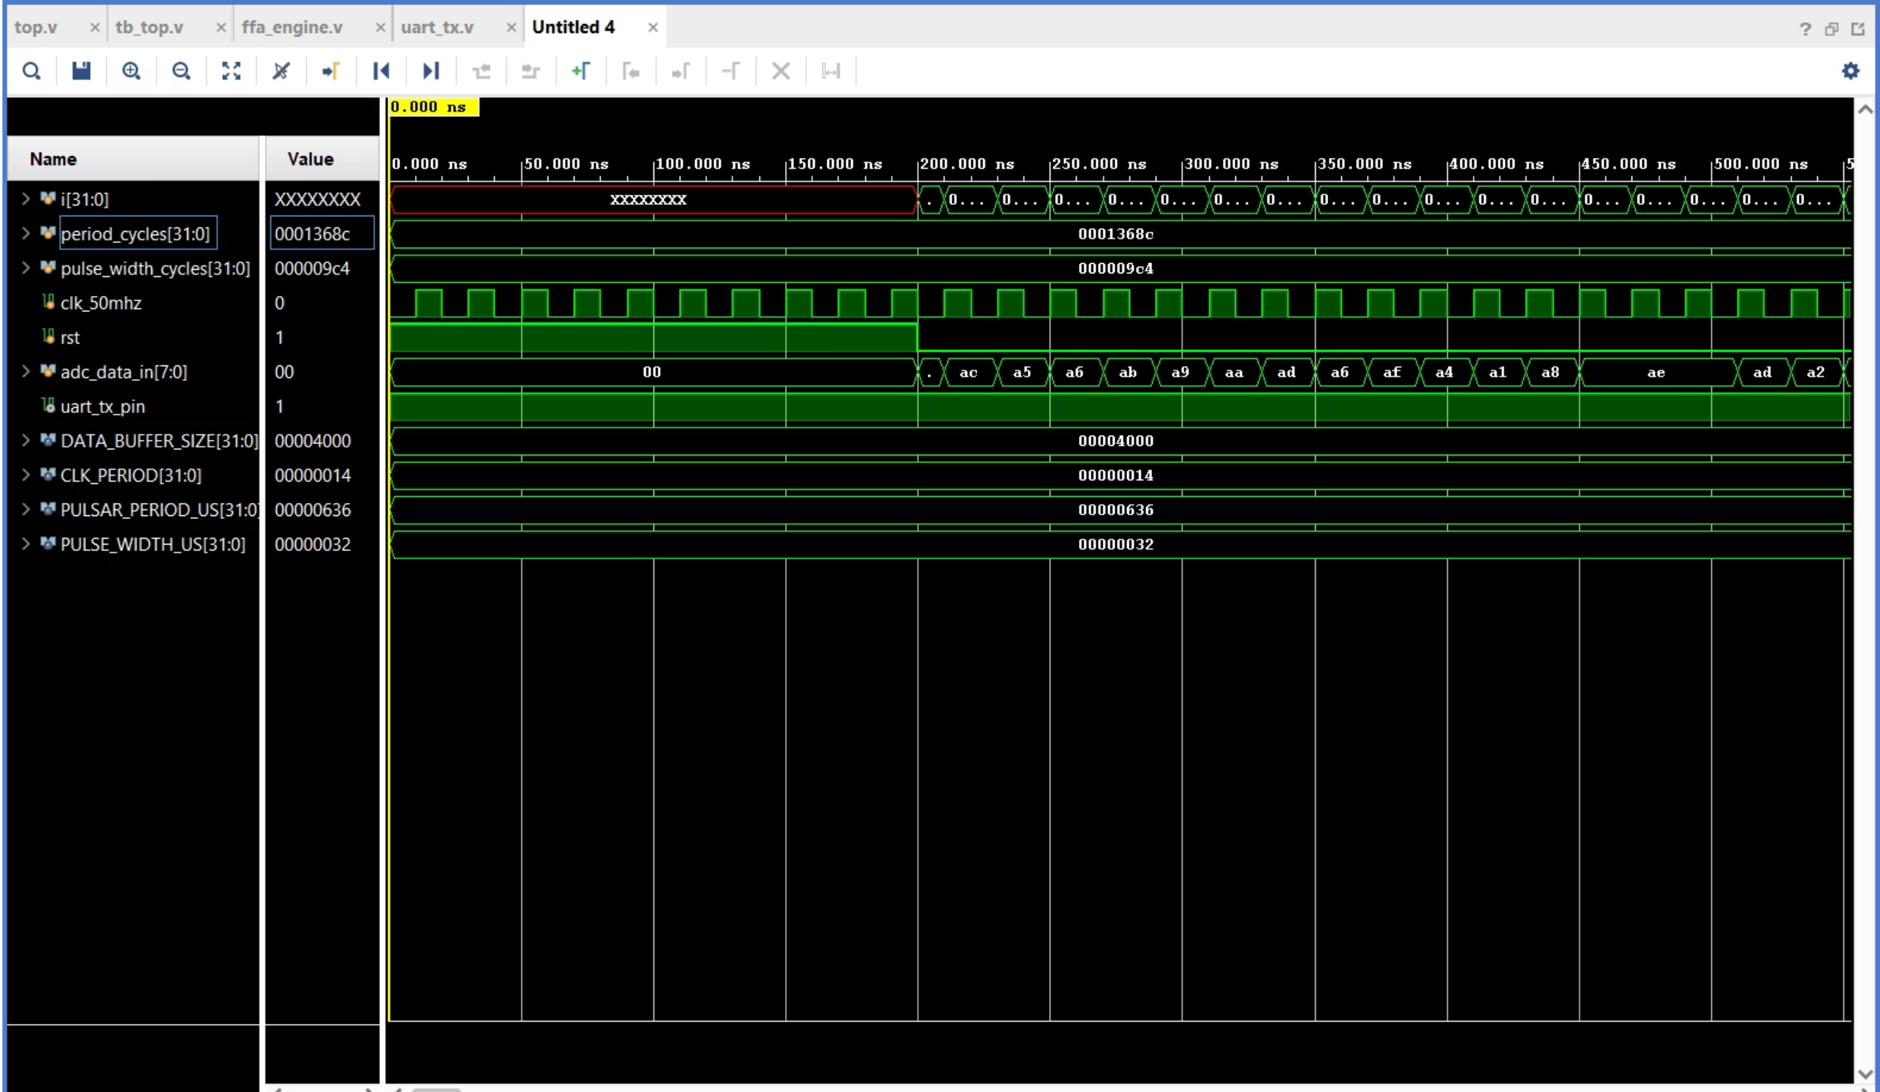
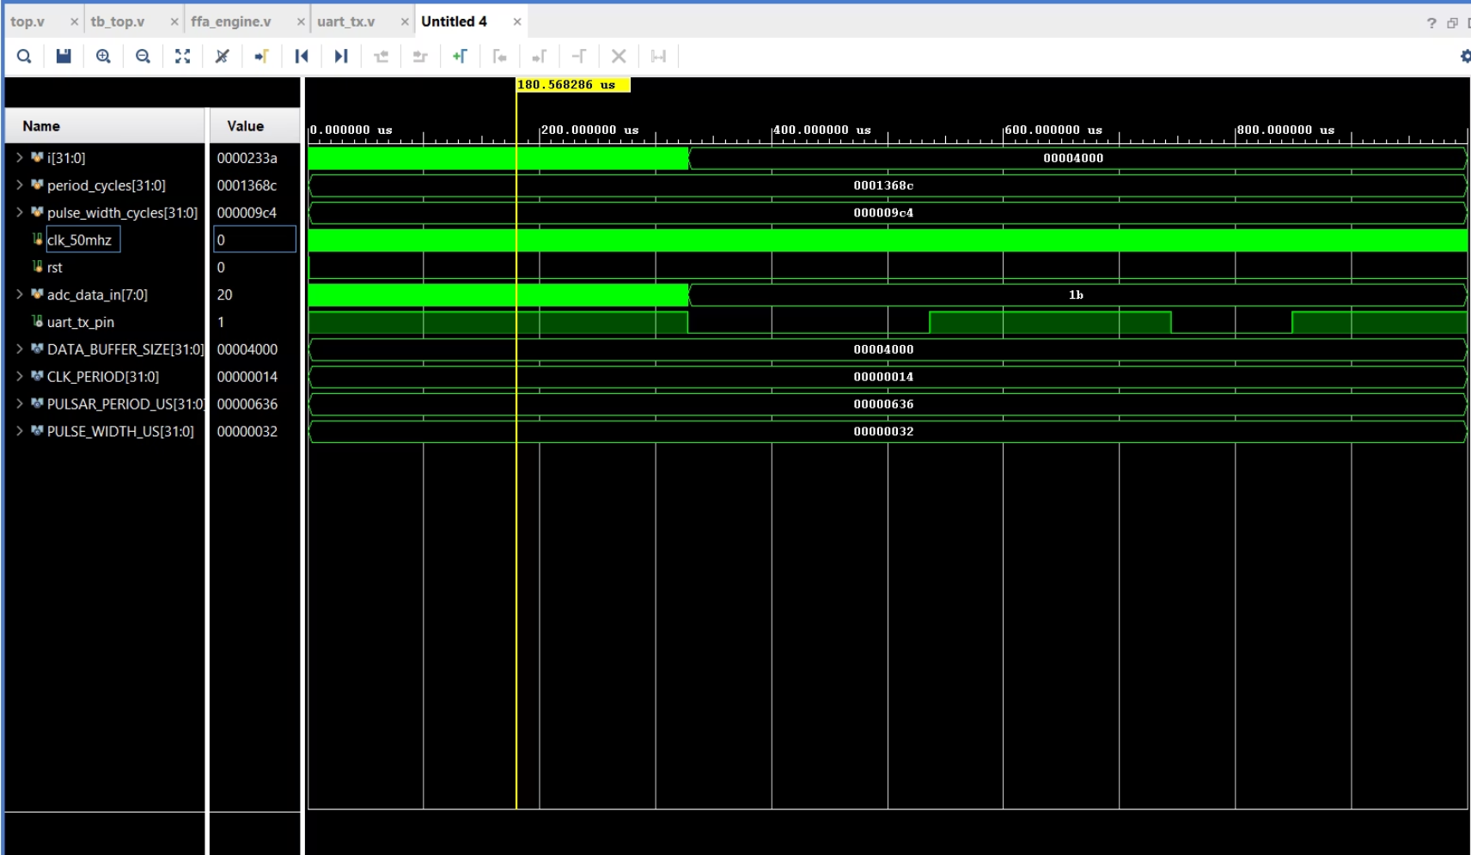
Expected output:

Slide 14

Key Achievements:
Successfully designed a real-time digital system architecture in Verilog for pulsar signal processing.
Developed a robust testbench to generate realistic, noisy pulsar signals for hardware verification.
Created a functional MATLAB model to visually prove the FFA concept and its effectiveness.
Built a Python backend that interfaces with the hardware via UART and queries the official ATNF Pulsar Catalogue for real-time identification

Slide 15
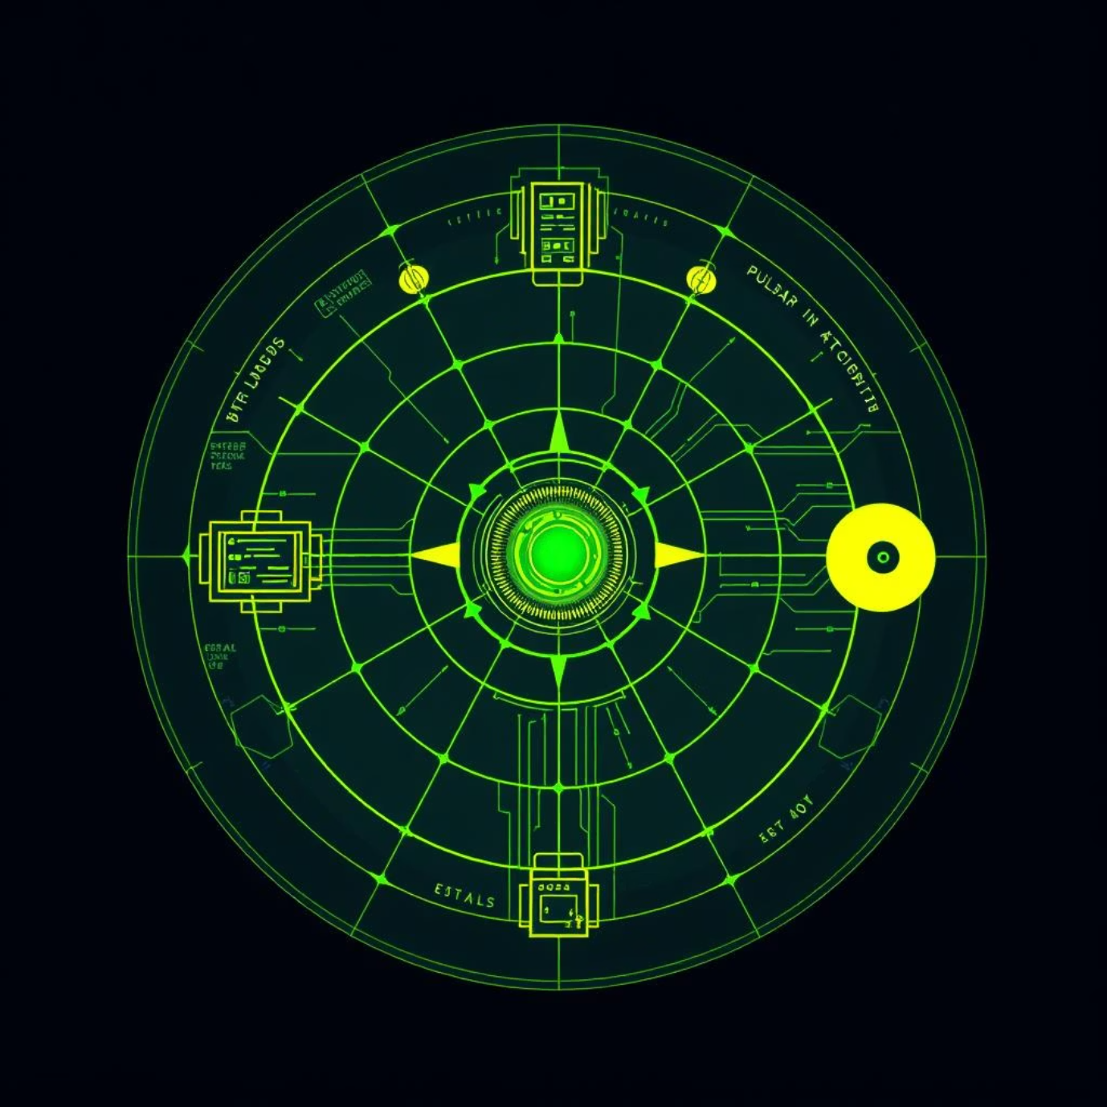
Future Scopes
Implement Full FFA in Verilog: The primary next step is to replace the placeholders in the ffa_engine with the complete, synthesizable logic for the folding and peak detection algorithms modeled in MATLAB.
Create a Standalone System: Port the Python backend to run on the Zynq-7000's ARM processor, creating a fully self-contained, low-cost embedded system for pulsar detection.
Add Dispersion Measure (DM) Correction: To handle real astronomical data, a DM correction module could be added to the hardware pipeline to remove the smearing effect caused by the interstellar medium.

